Slide 1
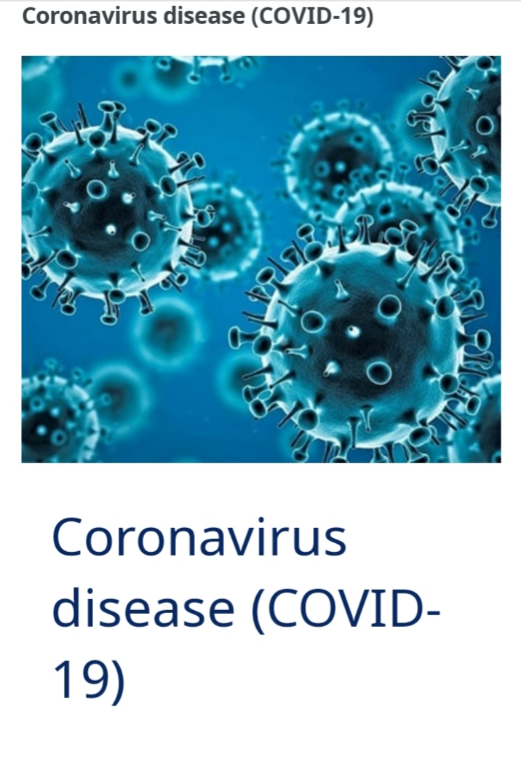

Slide 2
Definition and design thinking:
A preparation that is used to stimulate the body's immune response against diseases. vaccines are usually administered through needie injections,but some can be administered by mouth or sprayed into the nose.

Slide 3
Innovation :
prayed into the nose. DESIGN THINKING: 1.In this project we have analyzed the top 10 fully veaccined countries. 2.we have analyzed the top 5 daily vaccinating countries. 3.we have analyzed the total number of daily vaccinations,people who have fully vaccinated,people who is vaccinated. 4.we have analyzed year wise daily vaccinating details,fully vaccinated people details,vaccinated people

Slide 4
Development part 1 :
In power BI desktop with the help of the get data option import the CSV data which is named as country vaccinations and clicked load option. DATA CLEANING: After loading the data and after analyzing the data|understood that there are 86512 rows and 15 columns.And in that some of the columns contained null values have replaced the null values by 0 with the use of replace functions and started working on the data. VISUALIZATIONS: In visualization part with the help of power BI desktop software I have used different kinds of charts,graphs,cards and table to display the data in the format which will be easy to understand

Slide 5
Development part 2 :
this analysis part first I have analyzed the top 10 fully vaccinated countries by using area chart and have used the filter option to find the top countries . Here we analyzed the top 10 fully vaccinated countries in which india tops the list which indicates that people in the country where showing lots of interests to get vaccinated. And also analyzed top 5 vaccinated countries here also india tops the list. And then analyzed top 5 vaccinating countries and here china tops the list. And also we analyze the sum of daily vaccinating details,fully vaccinating and vaccinating people details. And our year wise analyse shows that 2021 was the peak year for every vaccination details.

Slide 6
Project documents and submission:
We analyze the sum of daily vaccinating details,fully vaccinating and vaccinating people details. And our year wise analyse shows that 2021 was the peak year for every vaccination details.

